Slide 1
Configuring and using the Quick Filters
In Primo VE NDE
Yoel Kortick | May 2026

Slide 2
Agenda
  Introduction
  Configuring the Quick Filters
  Using the Quick Filters in Primo VE NDE
  Changing the configuration

Slide 3

Introduction

Slide 4
Introduction
Quick filters enable users to filter search results quickly by commonly used facets:
  Available On Shelf
  Held by library
  Peer-reviewed Journals
  Open Access
In Primo VE NDE the institution can configure which quick filters appear in which Primo view and in which order they appear.

Slide 5
Configuring the Quick Filters

Slide 6
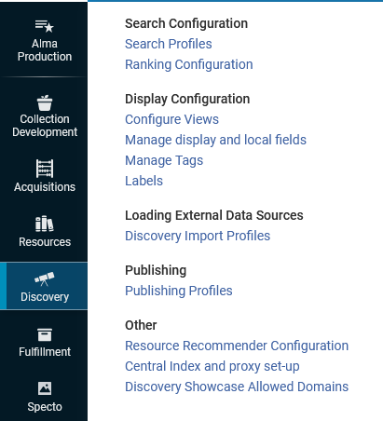
Configuring the Quick Filters
Edit the specific Primo VE NDE view at Configuration > Discovery > Display Configuration > Configure Views

Slide 7
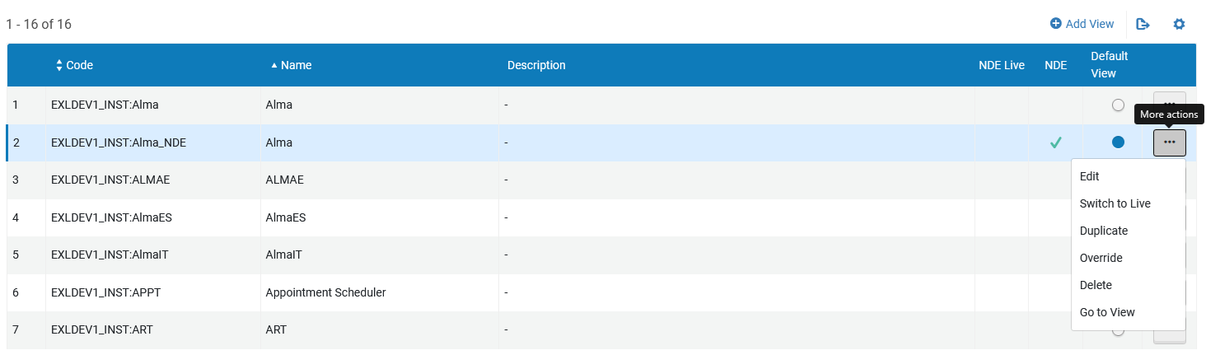
Configuring the Quick Filters
We will edit the view “EXLDEV1_INST:Alma_NDE”

Slide 8
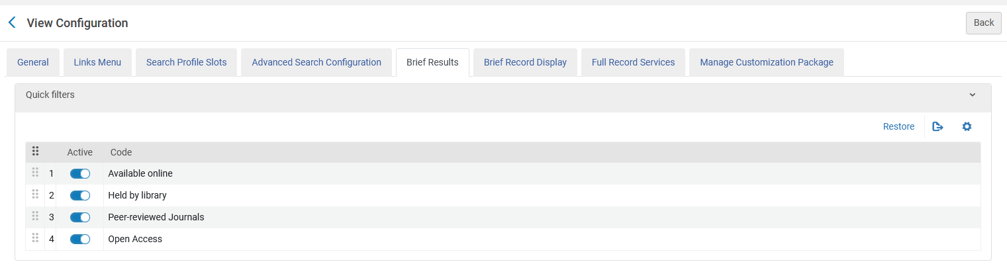
Configuring the Quick Filters
We have switched to the “Brief Results” tab and activate the following Quick Filters in the following order:
Available online, Held by library, Peer-reviewed Journals, Open Access

Slide 9
Using the Quick Filters in Primo VE NDE

Slide 10
Using the Quick Filters in Primo VE NDE
In the Primo VE NDE view which we just now configured (EXLDEV1_INST:Alma_NDE) we will perform a search for “Library Science” in the Library Catalog.
We will see that the four Quick Filters which we defined to appear are above the search results and appear in the same order we defined in the view.

Slide 11
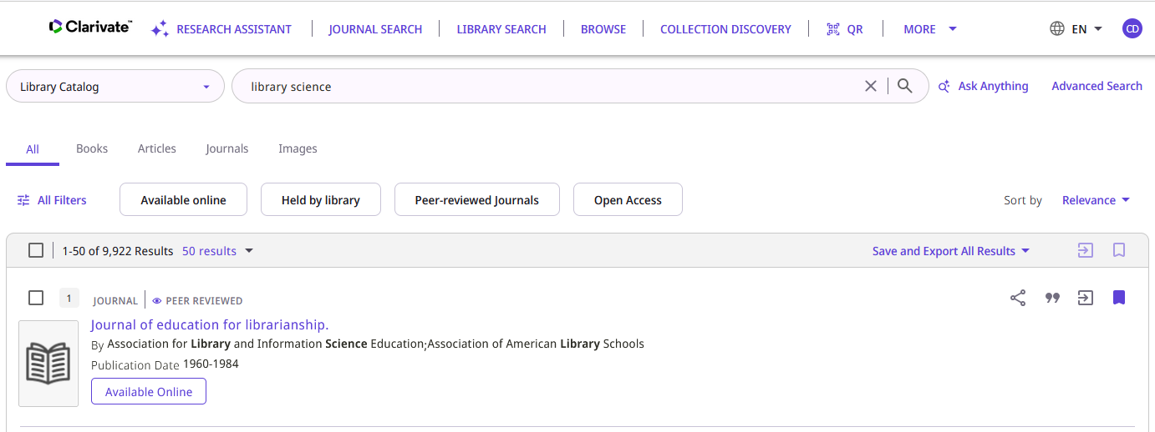
Using the Quick Filters in Primo VE NDE
The four Quick Filters which we defined to appear are above the search results and appear in the same order we defined in the view
We will now click “Open Access”

Slide 12
Using the Quick Filters in Primo VE NDE
  Having clicked the Quick Filter for “Open Access” we see that three events have occurred:
  The selected Quick Filter (Open Access) is shaded darkly to indicate that it is an active filter
  Other Quick Filters which are no longer relevant because they are no longer part of the new filter (in this case “Held By Library”) no longer appear. (There are no “Open Access” resources which are “Held By Library” hence it is an irrelevant filter)
  The results are all “Open Access” resources.

Slide 13
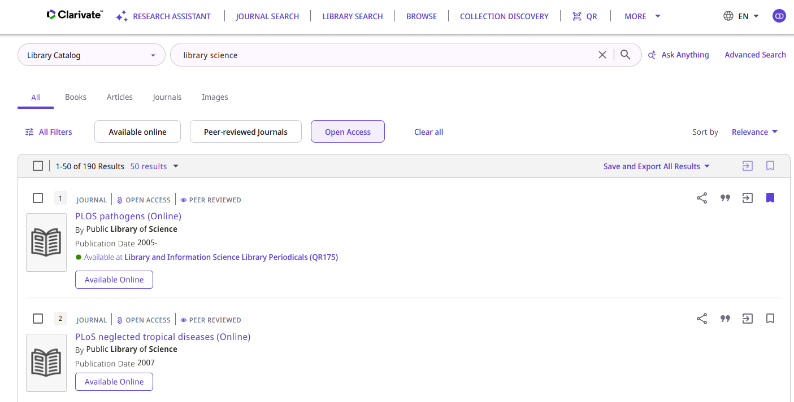
Using the Quick Filters in Primo VE NDE
The selected Quick Filter (Open Access) is shaded darkly to indicate that it is an active filter
“Held By Library” is irrelevant now and hence no longer appears as a filter
The results are all “Open Access” resources.

Slide 14
Changing the configuration

Slide 15
Changing the configuration
We will now change the configuration so that “Held By Library” will be last in the list and “Open Access” will no longer appear.
The next slide shows the “before” and “after” of the configuration.

Slide 16
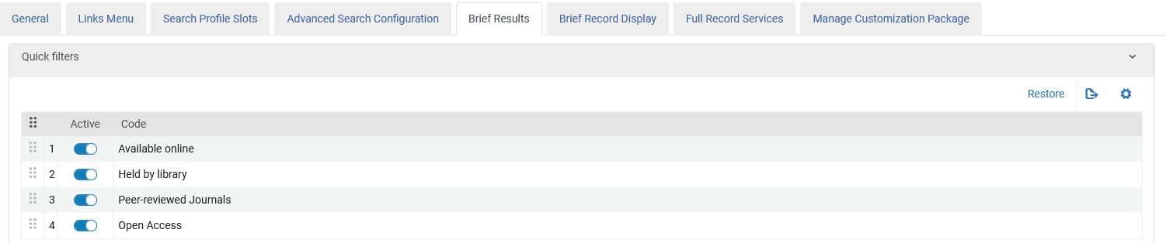
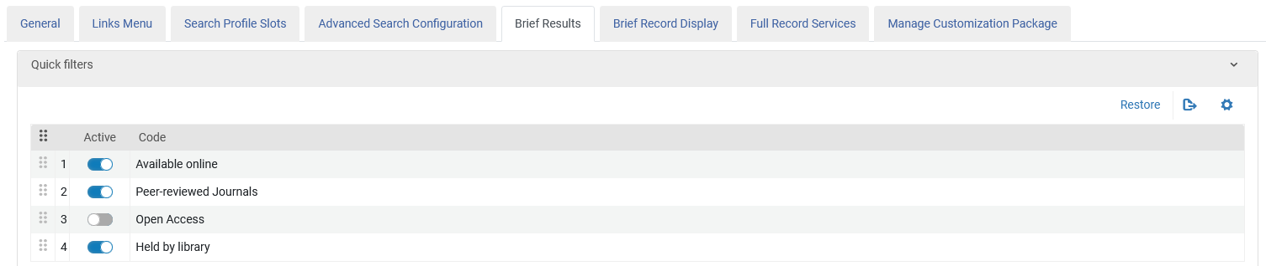
Changing the configuration
Before
After
“Open Access” is deactivated and “Held by library” has moved to the end

Slide 17
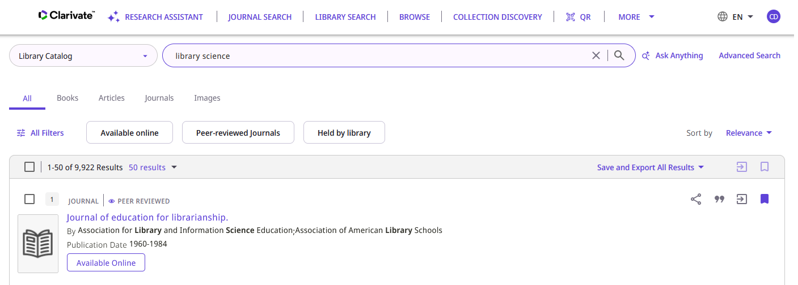
Changing the configuration
“Open Access” is deactivated and “Held by library” has moved to the end
We will now select “Held by library”

Slide 18
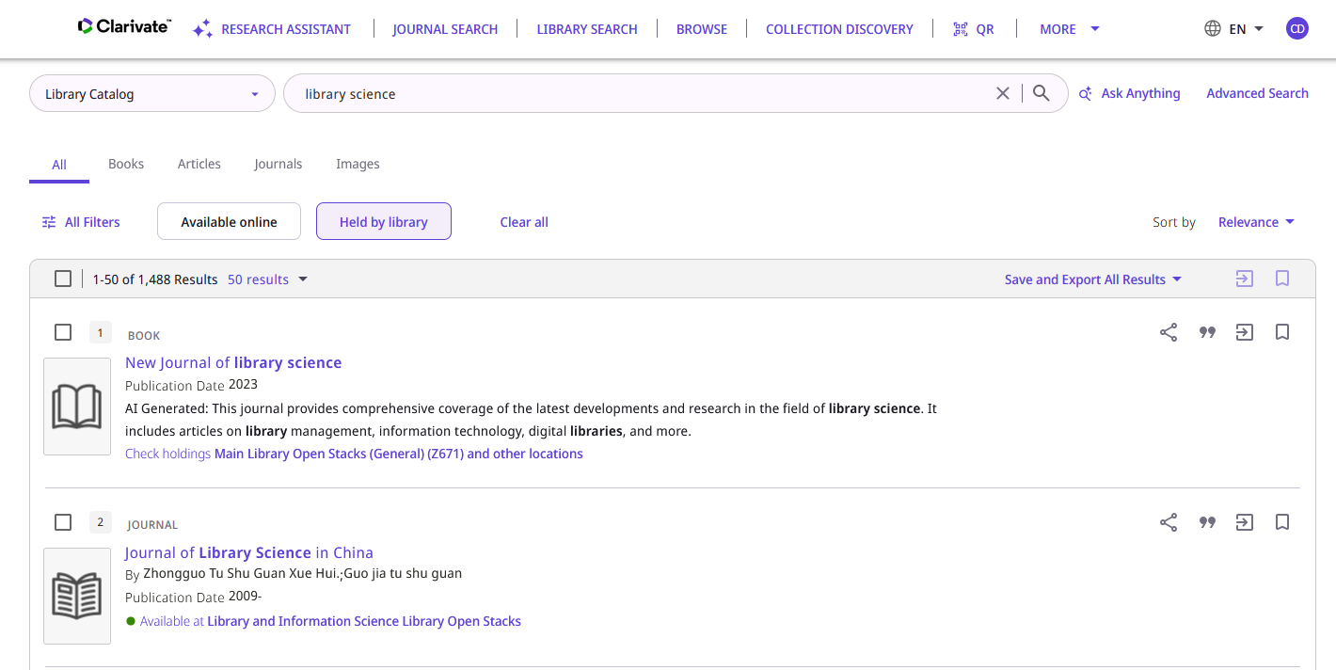
Changing the configuration
The selected Quick Filter (Held by library) is shaded darkly to indicate that it is an active filter
“Peer reviewed journals” is irrelevant now and hence no longer appears as a filter
The results are all “Held by library” resources.

Slide 19


Yoel Kortick
Yoel.Kortick@clarivate.com
About Clarivate
Clarivate is a leading global provider of transformative intelligence. We offer enriched data,
insights & analytics, workflow solutions and expert services in the areas of Academia & Government, Intellectual Property and Life Sciences & Healthcare. For more information, please visit clarivate.com.
© 2026 Clarivate. All rights reserved
Clarivate and its logo, as well as all other trademarks used herein are trademarks of their respective owners and used under license.

